Slide 1

Employee Management System (EMS)
The Employee Management System (EMS) is a comprehensive web-based application designed to streamline and enhance the management of human resources within organizations. Leveraging the power of Python, Flask, Appwrite, and Bootstrap, EMS offers a user-friendly and efficient platform for managing employees, departments, and HR-related tasks.

Slide 2

Introduction to EMS
Centralized Employee Data
Streamlined HR Processes
The system automates and simplifies various HR tasks, such as onboarding, leave management, and time tracking, enabling HR professionals to focus on strategic initiatives.
EMS provides a single, secure platform to store and manage all employee-related information, including personal details, employment history, and performance reviews.
Improved Collaboration
Insightful Analytics
EMS facilitates seamless communication and collaboration between employees, departments, and management, fostering a more engaged and productive workforce.
The system provides robust reporting and analytics capabilities, empowering HR and leadership teams to make data-driven decisions and identify areas for improvement.

Slide 3

Features of EMS
1
Employee Management
EMS allows users to easily add, update, and manage employee profiles, including personal information, job details, and performance evaluations.
2
Attendance Tracking
The system tracks employee attendance, leave, and overtime, providing a comprehensive view of workforce utilization and productivity.
3
HR Workflows
EMS automates and streamlines HR-related tasks, such as onboarding, training management, and performance reviews, improving efficiency and consistency.

Slide 4
Managing Employees
Employee Database
Attendance Tracking
Performance Reviews
EMS provides a centralized database to store and manage comprehensive employee records, including personal information, job details, and employment history.
The system tracks employee attendance, leave, and overtime, providing real-time data on workforce utilization and productivity.
EMS streamlines the performance review process, allowing managers to track employee goals, monitor progress, and provide feedback in a structured and organized manner.

Slide 5

Managing Departments
1
Organizational Structure
2
Resource Allocation
The system allows managers to efficiently allocate and manage resources, such as employees and equipment, across different departments and projects.
EMS enables users to define and manage the organizational hierarchy, including departments, teams, and reporting structures.
3
Interdepartmental Collaboration
4
Reporting and Analytics
The system provides comprehensive reporting and analytics capabilities, allowing managers to gain insights into departmental performance and identify areas for improvement.
EMS fosters collaboration and communication between departments, enabling seamless sharing of information, resources, and best practices.

Slide 6
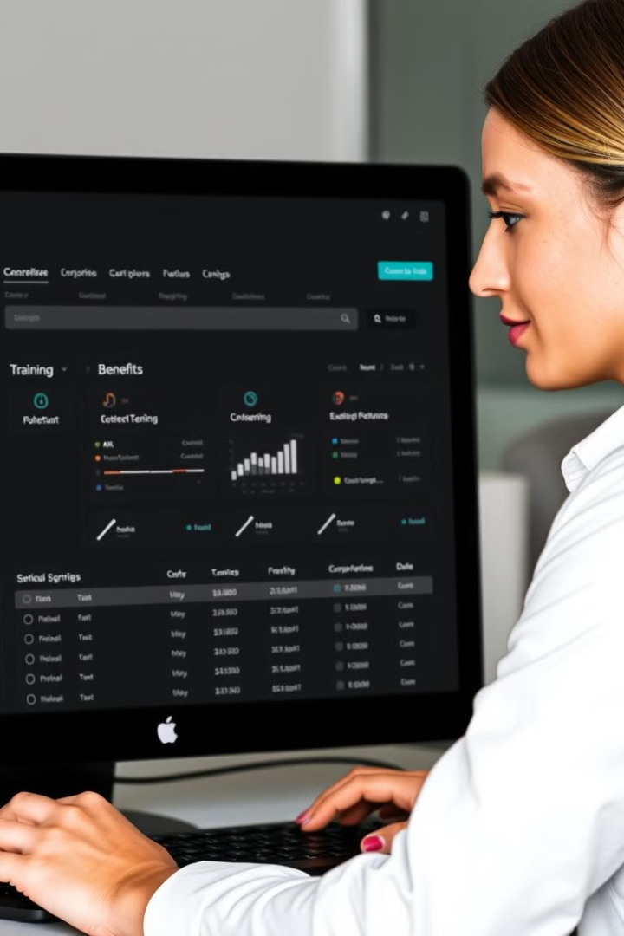




HR-related Tasks
Leave Management
Advance Salary Management
EMS streamlines the onboarding process, ensuring new hires are properly integrated into the organization and have access to all necessary resources.
The system helps HR professionals manage and track employee training programs, ensuring all personnel are equipped with the necessary skills and knowledge.
Benefits Administration
HR Analytics
EMS simplifies the management of employee benefits, such as health insurance, retirement plans, and leave policies, ensuring compliance and employee satisfaction.
The system provides robust reporting and analytics capabilities, enabling HR professionals to make data-driven decisions and identify areas for improvement.

Slide 7

User-friendly Interface
1
Intuitive Navigation
2
Personalized Dashboards
EMS features a modern and intuitive user interface, with clear and well-organized menus, making it easy for users to access the information and functionalities they need.
The system allows users to customize their dashboards, displaying the most relevant data and metrics based on their roles and responsibilities, enhancing efficiency and productivity.
3
Mobile Accessibility
EMS is designed with a responsive layout, enabling users to access the system from any device, whether they're in the office or on the go, ensuring seamless employee management on the move.

Slide 8

Powered by Python, Flask, Appwrite, and Bootstrap
Python and Flask
Appwrite
EMS is built using the Python programming language and the Flask web framework, which provides a robust and scalable foundation for the application's backend and API development.
The system leverages the Appwrite platform, an open-source backend as a service (BaaS) solution, to handle various backend functionalities, such as user authentication, data storage, and real-time updates.
Bootstrap
The user interface of EMS is built using the Bootstrap front-end framework, ensuring a responsive and visually appealing design that works seamlessly across different devices and screen sizes.

Slide 9




Future Scope
Prototype
EMS is currently in the prototype stage, with the core functionality and user interface being actively developed and refined based on user feedback and requirements.
Iterative Improvement
The development team is working closely with potential users and stakeholders to continuously enhance the system, addressing pain points and incorporating new features to meet evolving business needs.
Future Release
As the prototype matures, the goal is to launch a fully functional and user-friendly version of EMS, providing organizations with a comprehensive and efficient employee management solution.

Slide 10

Conclusion and Future Enhancements
The Employee Management System (EMS) is a powerful and innovative solution that streamlines and enhances the management of human resources within organizations. Leveraging cutting-edge technologies and a user-centric design, EMS offers a comprehensive platform for managing employees, departments, and HR-related tasks. As the system continues to evolve and improve, the development team is committed to incorporating additional features and capabilities, such as advanced analytics, employee engagement tools, and seamless integration with third-party applications, ensuring that EMS remains a leading-edge solution in the employee management landscape.

Slide 11
Code Demonstration
Let's look at how the Employee Management System works through a practical code example. We'll now pause this presentation briefly to switch to a live code demonstration, after which we'll return here to continue discussing the system.
We will be Back after Code Demo

Slide 12
Team Contributions
Shreya Shahi
Aayan Shaikh
Development of login page functionality and interface
Implementation of registration page system
Ayan Shaikh
Saaem Shaikh
Creation of password recovery system
Design and development of Home Page
Amankumar Sharma
Pawan Shetty
Implementation of Follow Up page features
Development of request advance salary page , employee salary management system , Flask APIs and Appwrite database setup
Rishith Shetty
Aryan Shinde
Development of request leave page
Implementation of edit employee details functionality
Rohit Shinde
Anmol Shukla
Development of employee list page
Implementation of employee leave salary management system

Slide 13
Individual Code Explanations
We will now proceed with individual demonstrations where each team member will explain their code contributions in detail.
Each member will showcase their specific implementation and technical approach.
We will resume the presentation after all individual demonstrations are complete.

Slide 14
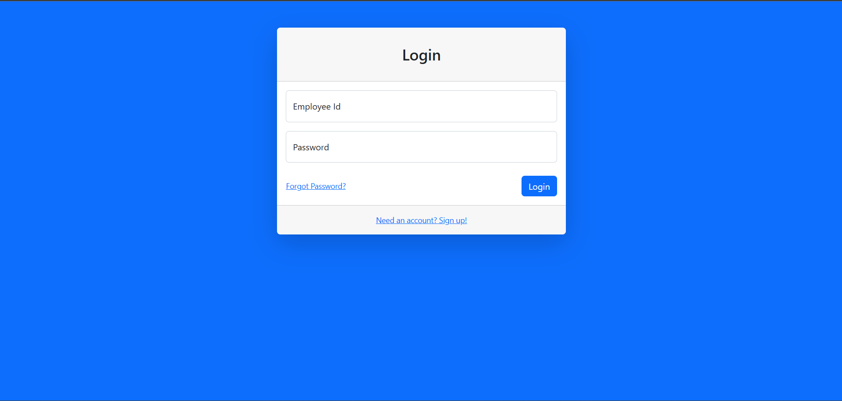
Code Contribution: Login Page Implementation
Shreya Shahi's Contribution
Key developer of the login page functionality and user interface.
Implementation of user authentication system
Design of responsive login interface
Integration with backend services

Slide 15
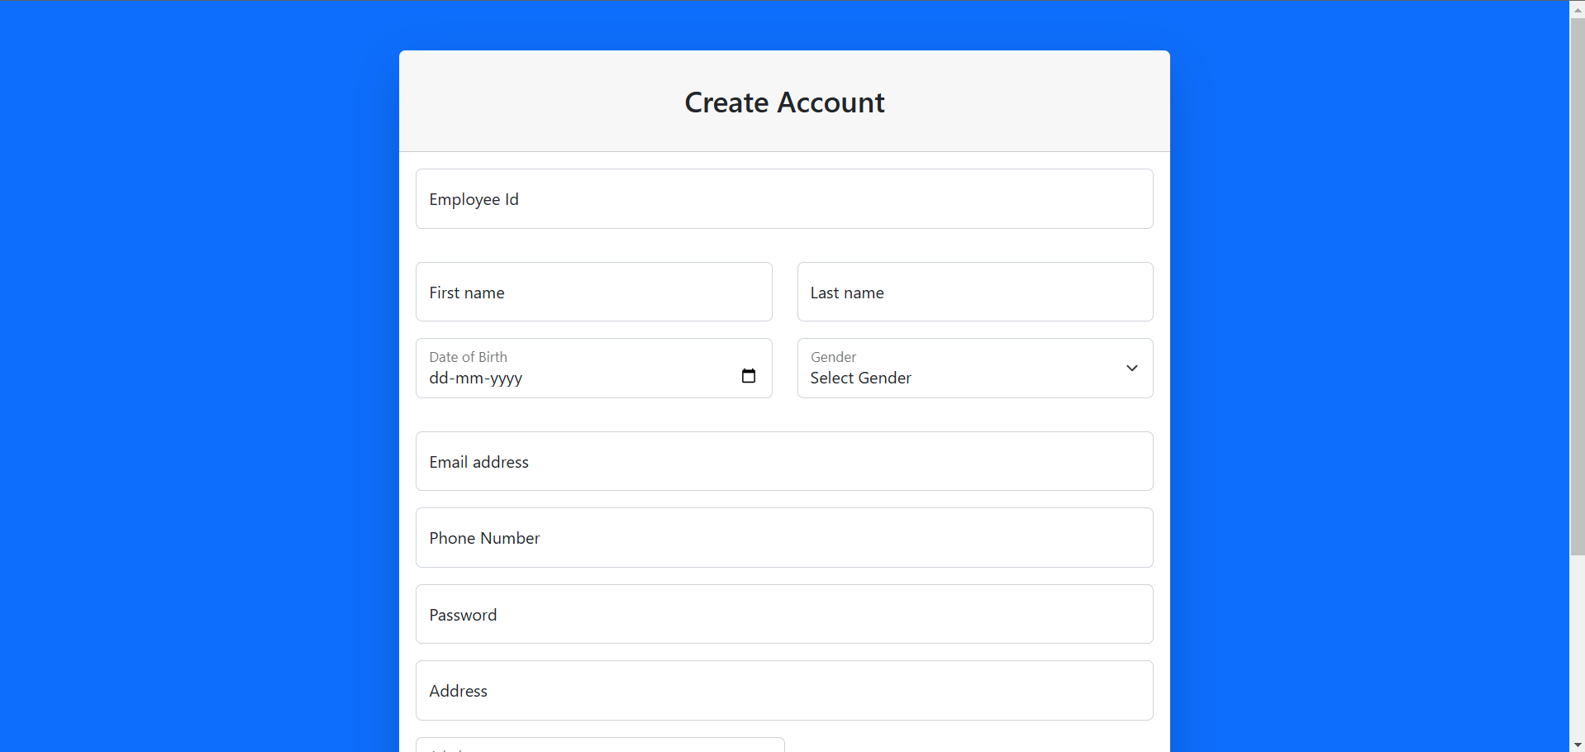
Code Contribution: Registration Page Implementation
Aayan Shaikh's Contribution
Key developer of the registration system and user interface.
Implementation of user registration workflow
Design of intuitive registration form interface
Integration with database and validation systems

Slide 16
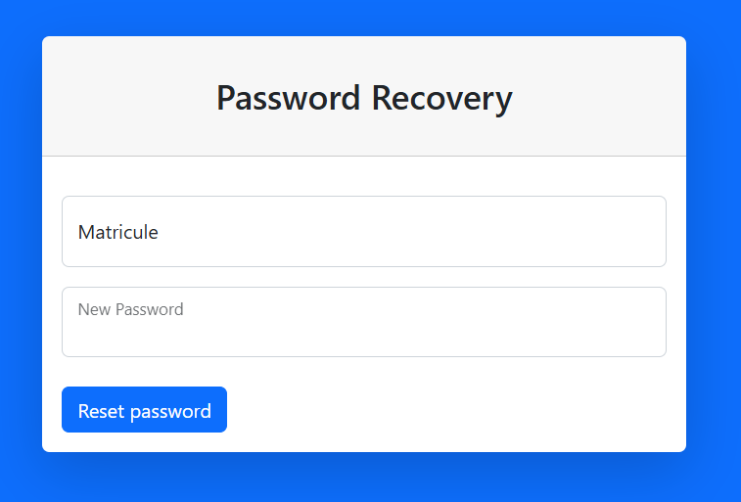
Code Contribution: Forget password Page
Ayan Shaikh's Contribution
Key developer of the password recovery system and security features.
Implementation of secure password reset workflow
Development of email notification system
Integration with authentication services

Slide 17
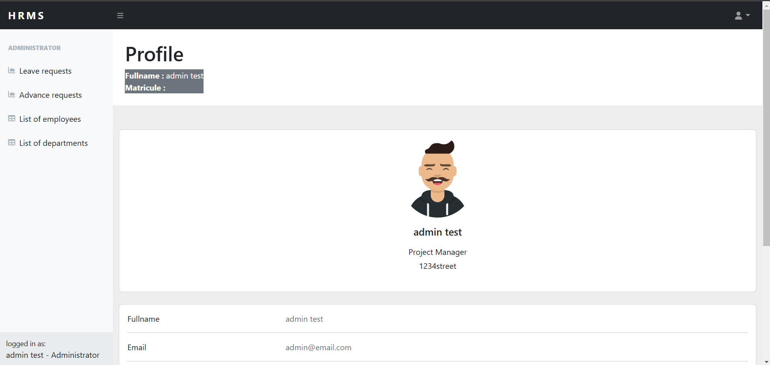
Code Contribution: Home Page
Saaem Shaikh's Contribution
Key developer of the Home Page of the EMS.
Developed a homepage based on Bootstrap and Tailwind CSS.
Implemented a secure password reset workflow.
Developed the email notification system and integrated it with authentication services.

Slide 18
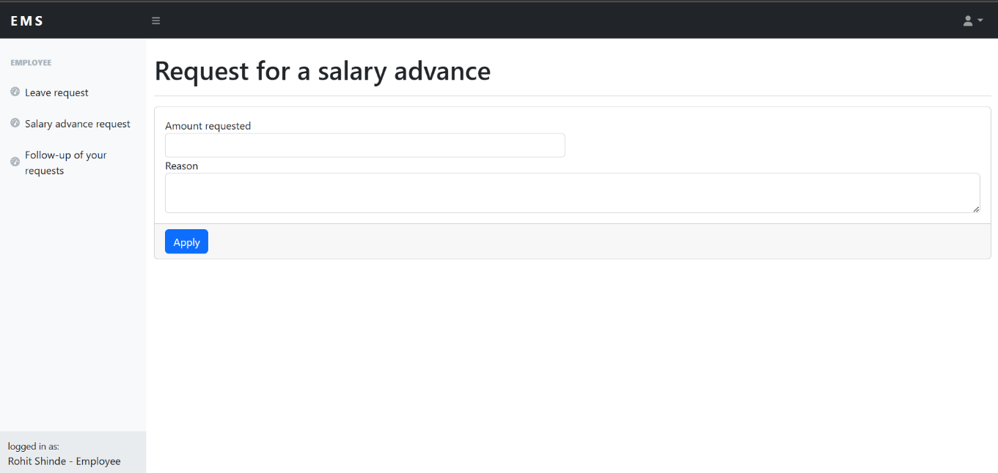
Code Contribution: Follow Up page
Amankumar Sharma's Contribution
Key developer of the Follow Up page and associated features.
Integrated the follow-up system with the user authentication services.
Implemented the user interaction flow for follow-ups.
Developed the notification system for follow-up reminders.

Slide 19
Code Contribution: Request advance salary page , Employee salary management page,
API routings and Appwrite database
Pawan Shetty's Contribution
Key developer of the Request Advance Salary page and Employee Salary Management pag
Implemented salary request workflow for advance payments.
Developed the notification system for salary status updates.
Integrated the salary management system with user authentication services.

Slide 20
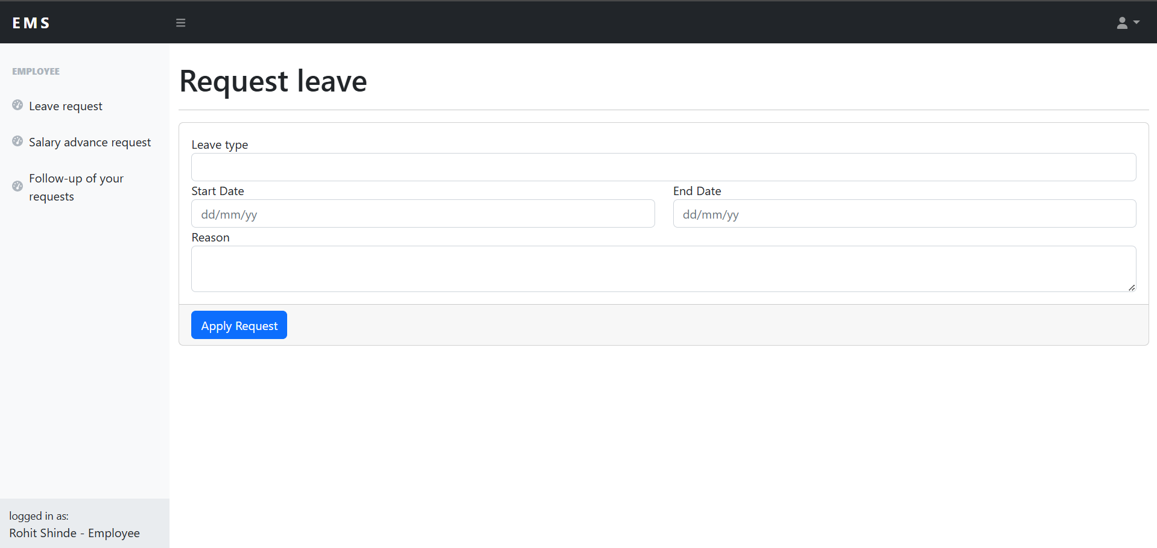
Code Contribution: Request leave page
Rishith Shetty's Contribution
Key developer of the Request Leave page and related features.
Implemented the leave request workflow and approval system.
Developed the email notification system for leave status updates.
Integrated the leave management system with user authentication services.

Slide 21
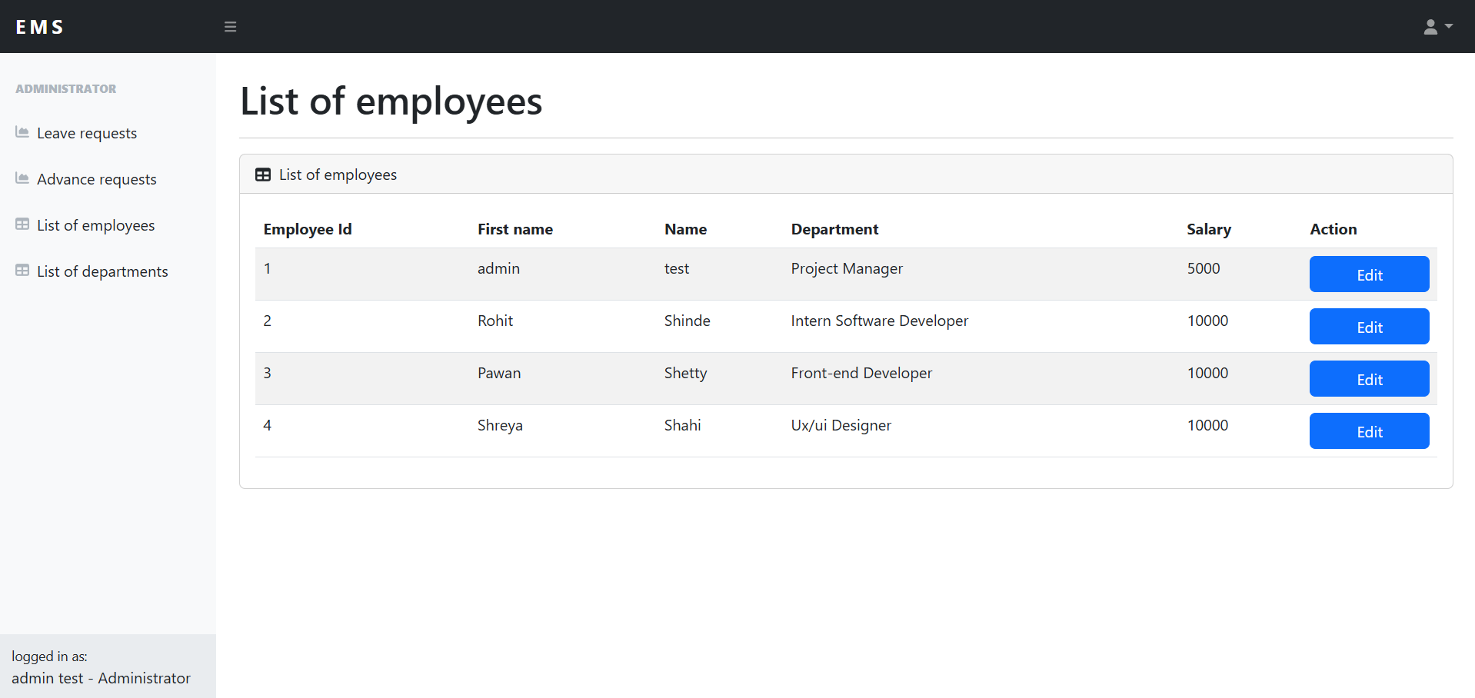
Code Contribution: Edit employee details Page
Aryan Shinde's Contribution
Key developer of the Edit Employee Details page and associated features.
Implemented the employee details update workflow and validation
Developed the notification system for successful updates and changes.
Integrated the employee management system with user authentication services

Slide 22
Code Contribution: Employee List Page Implementation
Rohit Shinde's Contribution
Key developer of the employee list page functionality and interface.
Implementation of employee data display system
Development of search and filter functionality
Integration with database for employee records management

Slide 23
Code Contribution: Employee leave salary management
Anmol Shukla's Contribution
Key developer of the employee listing system and management interface.
Implementation of employee data display and management system
Design of efficient list view interface
Integration with database and filtering systems

Slide 24
Thank You
We appreciate your time and attention in learning about our Employee Management System. This innovative solution combines powerful features with user-friendly design to streamline HR operations.
Our team remains committed to continuous improvement and development of EMS to meet your organization's evolving needs.
Presented by Group-2—AIML(C).

